Slide 1
Recursion in C
By: nida munawar

Slide 2
Recursion
When a function invokes itself, the call is known as a recursive call.
Recursion (the ability of a function to call itself) is an alternative control structure to repetition (looping). Rather than use a looping statement to execute a program segment, the program uses a selection statement to determine whether to repeat the code by calling the function again or to stop the process.

Slide 3
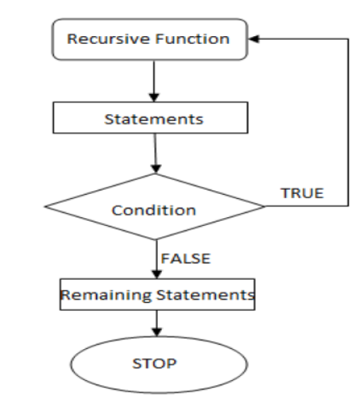
Recursion
Flowchart for recursion:

Slide 4
Recursion
Each recursive solution has at least two cases: the base case and the general case.
The base case is the one to which we have an answer;
the general case expresses the solution in terms of a call to itself with a smaller version of the problem. Because the general case solves a smaller and smaller version of the original problem, eventually the program reaches the base case, where an answer is known, and the recursion stops.

Slide 5
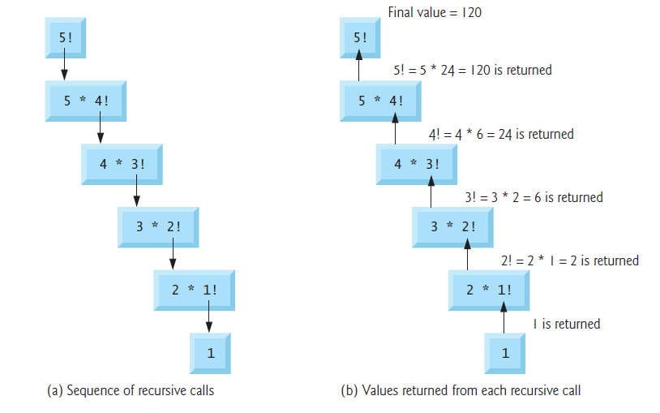
Recursion

Slide 6
Recursion
Example: factorials
5! = 5 * 4 * 3 * 2 * 1
Notice that
5! = 5 * 4!
4! = 4 * 3! ...
Can compute factorials recursively
Solve base case (1! = 0! = 1) then plug in
2! = 2 * 1! = 2 * 1 = 2;
3! = 3 * 2! = 3 * 2 = 6;

Slide 7
Recursion
For example, a classic recursive problem is the factorial. The factorial of a number is defined as the number times the product of all the numbers between itself and 0: N! = N * (N-1)!
The factorial of 0 is 1. We have a base case, Factorial (0) is 1, and we have a general case, Factorial (N) is N * Factorial (N-1). An if statement can evaluate N to see if it is 0 (the base case) or greater than 0 (the general case). Because N is clearly getting smaller with each call, the base case is reached.

Slide 8
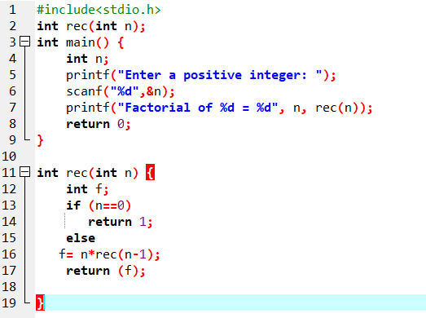
Recursion

Slide 9
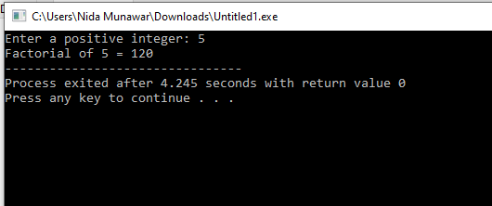

Slide 10
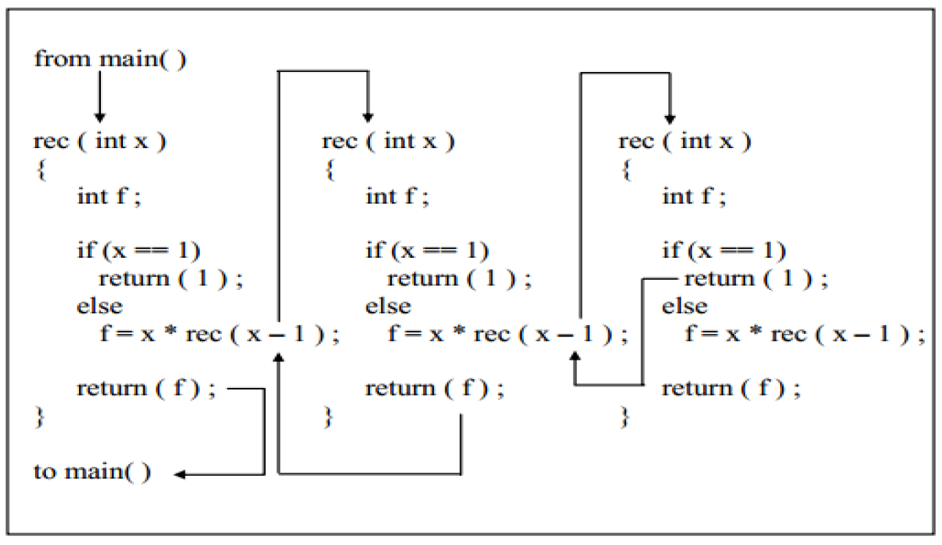
Recursion
Assume that the number entered through scanf( ) is 3. The figure below explains what exactly happens when the recursive function rec( ) gets called.

Slide 11
Example Using Recursion: The Fibonacci Series
Fibonacci series: 0, 1, 1, 2, 3, 5, 8...
Each number is the sum of the previous two
Can be solved recursively:
fib( n ) = fib( n - 1 ) + fib( n – 2 )
Code for the fibonacci function
long fibonacci( long n )
{
if (n == 0 || n == 1) // base case
return n;
else
return fibonacci( n - 1) + fibonacci( n – 2 );
}

Slide 12
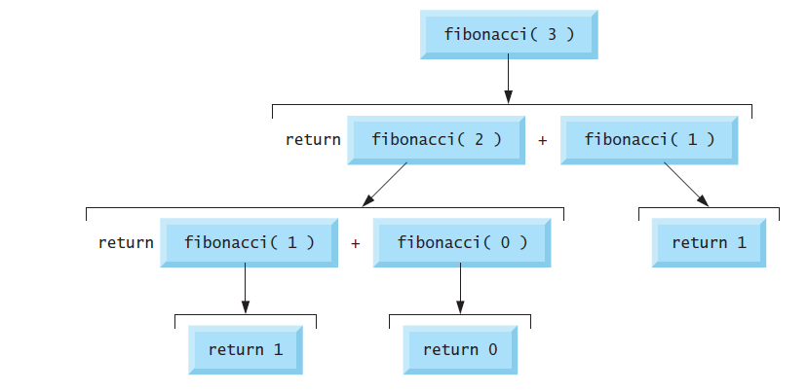
Example Using Recursion: The Fibonacci Series
Set of recursive calls to function Fibonacci

Slide 13
Recursion vs. Iteration
Repetition
Iteration: explicit loop
Recursion: repeated function calls
Termination
Iteration: loop condition fails
Recursion: base case recognized
Both can have infinite loops
Balance
Choice between performance (iteration) and good software engineering (recursion)

Slide 14
Recursion
Disadvantages of recursion
– Recursive programs are generally slower than non-recursive programs. This is because, recursive function needs to store the previous function call addresses for the correct program jump to take place.
– Requires more memory to hold intermediate states. It is because, recursive program requires the allocation of a new stack frame and each state needs to be placed into the stack frame, unlike non-recursive (iterative) programs.

Slide 15
Recursion Practice Questions
Display series from 1 to 10.
Display following pattern:
a
a b
a b c
a b c d
a b c d e
Get the character and display until he/she hits the enter key. Finally show the count of total typed characters.

